Slide 1
Upcoming Assignments
sc 1, 2, 3, 4, 5
Sc 7, 8, 10, 11, 15, 16
sc 18, 19, 20, 21
sc 22, 23, 25, 26, 27
ex1, 2, 3, 4 18-22
Monday project
quiz review—project lab
quiz

Slide 2
TimeSpan
public class TimeSpan { int hours; int minutes; public TimeSpan(int hours, int minutes) { hours = 0; minutes = 0; add(hours, minutes); } public void add(int hours, int minutes) { this.hours += hours; this.minutes += minutes; while (minutes > 60) { minutes -= 60; // convert 60 min --> 1 hour hours++; } } public void add(TimeSpan time) { add(time.hours, time.minutes); } public double getTotalHours() { return hours + minutes / 60.0; } public String toString() { return hours + "h" + minutes + "m"; } }

Slide 3
8.4 Encapsulation

Slide 4
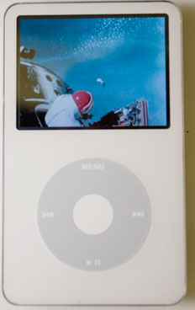
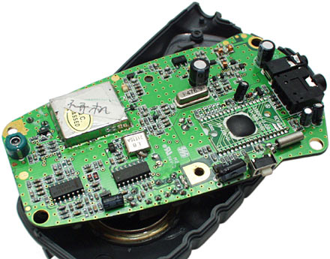
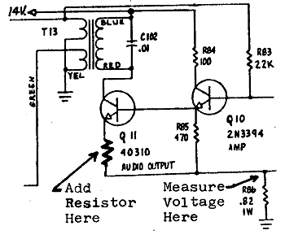
Encapsulation
encapsulation: Hiding implementation details from clients.
Encapsulation forces abstraction.
separates external view (behavior) from internal view (state)
protects the integrity of an object's data

Slide 5
Private fields
A field that cannot be accessed from outside the class
private type name;
Examples:
private int x;
private int y;
Client code won't compile if it accesses private fields:
PointMain.java:11: x has private access in Point
System.out.println(p1.x);
^

Slide 6
Accessing private state
// A "read-only" access to the x field ("accessor")
public int getX() {
return x;
}
// Allows clients to change the x field ("mutator")
public void setX(int newX) {
x = newX;
}
Client code will look more like this:
System.out.println(p1.getX());
p1.setX(14);

Slide 7
Point class, version 4
// A Point object represents an (x, y) location.
public class Point {
private int x;
private int y;
public Point(int initialX, int initialY) {
x = initialX;
y = initialY;
}
public int getX() {
return x;
}
public int getY() {
return y;
}
public double distanceFromOrigin() {
return Math.sqrt(x * x + y * y);
}
public void setLocation(int newX, int newY) {
x = newX;
y = newY;
}
public void translate(int dx, int dy) {
setLocation(x + dx, y + dy);
}
}

Slide 8
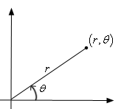
Benefits of encapsulation
Protects object from unwanted access
Example: Can't fraudulently increase an Account's balance.
Can change the class implementation later
Example: Point could be rewritten in polar coordinates (r, θ) with the same methods.
Can constrain objects' state (invariants)
Example: Only allow Accounts with non-negative balance.
Example: Only allow Dates with a month from 1-12.

Slide 9
The this keyword
this : Refers to the implicit parameter inside your class.
(a variable that stores the object on which a method is called)
Refer to a field: this.field
Call a method: this.method(parameters);
One constructor this(parameters); can call another:

Slide 10
toString()
public String toString() {
return this.x + ", " + this.y;
}

Slide 11
Calling Constructors From Constructors
Sometimes you want to reuse constructor code
You can call one constructor from another
But it has to be the first call in the constructor

Slide 12
Fraction
private int numerator;
private int denominator;
public Fraction(int numerator, int denominator) {
this.numerator = numerator;
this.denominator = denominator;
}
public Fraction(int whole, int numerator, int denominator) {
this(whole * denominator + numerator, denominator);
}

Slide 13
Not Like This
private int numerator;
private int denominator;
public Fraction(int numerator, int denominator) {
this.numerator = numerator;
this.denominator = denominator;
}
public Fraction(int whole, int numerator, int denominator) {
numerator = whole * denominator + numerator;
this (numerator, denominator);
}
Needs to be first

Slide 14
There’s Always Another Way
private int numerator;
private int denominator;
public Fraction(int numerator, int denominator) {
initialize(numerator, denominator);}
public Fraction(int whole, int numerator, int denominator) {
numerator = whole * denominator + numerator;
initialize(numerator, denominator);
}
private initialize (int numerator, int denominator) {
// do stuff . . .

Slide 15
Be Careful During Construction
Object may not yet be complete, you cannot guarantee correctness
Some invariants may not be yet be in place
Need to be careful calling other instance methods from constructor
Previous example only calls method used for initialization
This is a pattern you define
The compiler will not enforce this for you

Slide 16
multiply() With Yourself
public Fraction multiply(Fraction fraction) {
int numerator = this.numerator * fraction.numerator;
int denominator = this.denominator * fraction.denominator;
return new Fraction (numerator, denominator);/* third fraction */
}
It says a third fraction? Where are the other two?
One fraction is passed in as a parameter
The other fraction is the object itself

Slide 17
Upcoming Assignments
sc 1, 2, 3, 4, 5
Sc 7, 8, 10, 11, 15, 16
sc 18, 19, 20, 21
sc 22, 23, 25, 26, 27
ex1, 2, 3, 4 18-22
Monday project
Due 1/21--project due
1/15-6 quiz review—project lab
1/17 quiz

